Slide 1
timeout
timeout
$ADROT
,
0_{data}|1_{sys}
,
[0…9]_{position}
S
$ADVER,1.00\r\n
wrong version
$FSBA1
,
strBAT1[4]
$ADNAK\r\n
$FSVER,1.00\r\n
$ADACK\r\n
$FSBA2
,
strBAT2[4]
$FSROW
,
char[0…24]
\r\n
$ADACK\r\n
$FSOFF
,
LCD|BA1|BA2
$FSON
,
LCD|BA1|BA2
$FSTGV
,
0-255_{accu}
,
0-255_{brkL}
,
0-255_{brkR}
unknown
$ADNAK\r\n

Slide 2
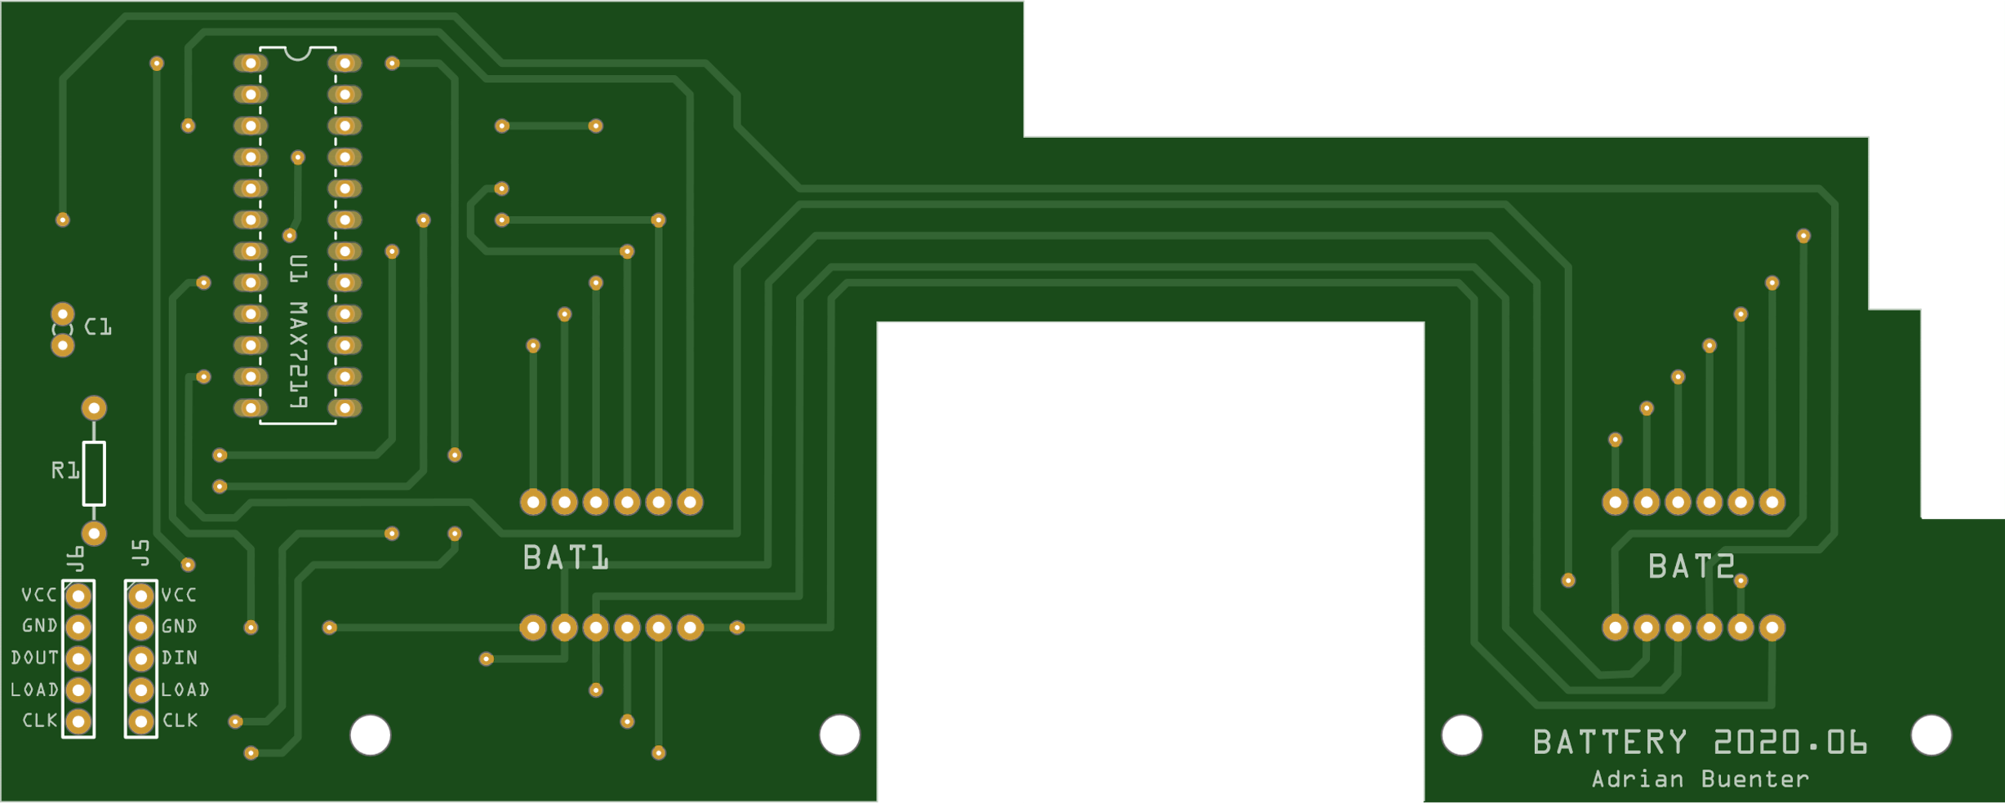
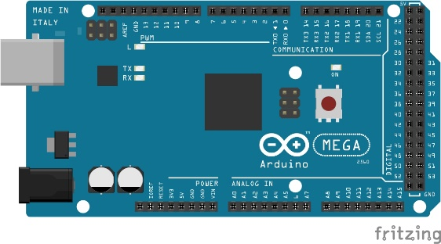
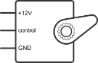
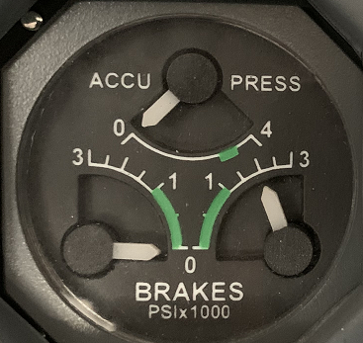
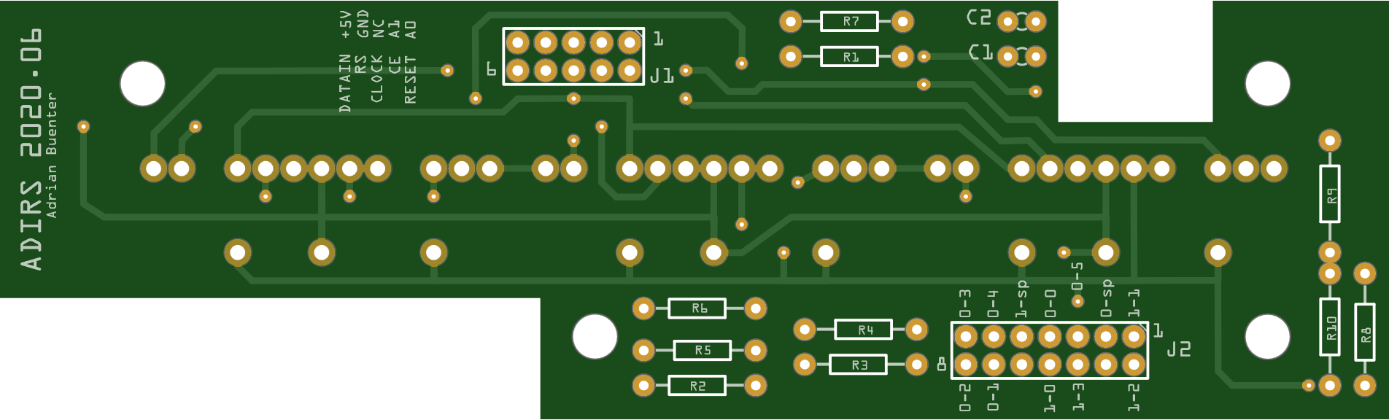
Digital: D10, D11, D12 (MAX7219)
Battery BAT1 and BAT2 display
Arduino MEGA 2560
USB: PC runing FSUIPC
PWM: D7, D8, D9 (servo)
3x servo of Triple Gauge
DATA
SYS
Digital: D2, D3, D4, D5, D6 (3x HCMS-2912)
Analog: A0, A1 (rotary)
ADIRS display (24 characters) and rotary switch encoder to analog

